Slide 1
“Food delivery website”
Task - 5

Slide 2
Food delivery website
Online Dining Convenience: Enjoy restaurant-quality meals delivered to your doorstep with ease.
A Culinary Marketplace: Explore diverse menus, place orders, and satisfy your cravings effortlessly.
Seamless Ordering: Customize, pay securely, and track your orders in real-time for a smooth experience.
Supporting Local Businesses: Help local restaurants grow while enjoying a variety of culinary delights.
LMS Username | Name | Batch
au721220104303 | Nagaraj N | Cd1_16
au721220104302 | Dharanish D | Cd1_16
au721220104021 | Lankeesh S | Cd1_16
au721220104501 | Hariprasath K | Cd1_16

Slide 3
Web Page Development and Authentication"
Use of JavaScript for temporary authentication:Explain how JavaScript is employed to manage authentication dynamically.
Dynamic nature of signup and login processes:
the signup and login procedures are flexible and responsive, thanks to the dynamic nature enabled by JavaScript.
Utilization of JavaScript for dynamic content manipulation:
Elaborate on how JavaScript is employed to manipulate content dynamically on the web page. This could include form validation, updating UI elements, or handling user interactions.

Slide 4
Explanation of temporary authentication methods:
Provide details on the temporary authentication methods implemented using JavaScript. This might involve using temporary tokens, session storage, or other techniques to manage user authentication during their session.
CSS enhancements for an improved user interface:Discuss specific enhancements made using CSS to improve the visual appeal and user experience of the web page. This could include styling forms, layout adjustments, or responsive design.

Slide 5
"Client-Side Authentication with JavaScript"
Begin by introducing the concept of client-side authentication, emphasizing its role in the context of web development. Explain that this approach involves handling user authentication directly on the user's device, reducing the need for constant communication with the server.

Slide 6
"Future Improvements"
Multi-Factor Authentication (MFA):
Explore the possibility of implementing MFA on the client side for enhanced security.Integration with Server-Side Authentication:Discuss plans for integrating client-side authentication with server-side processes to create a robust authentication system.

Slide 7
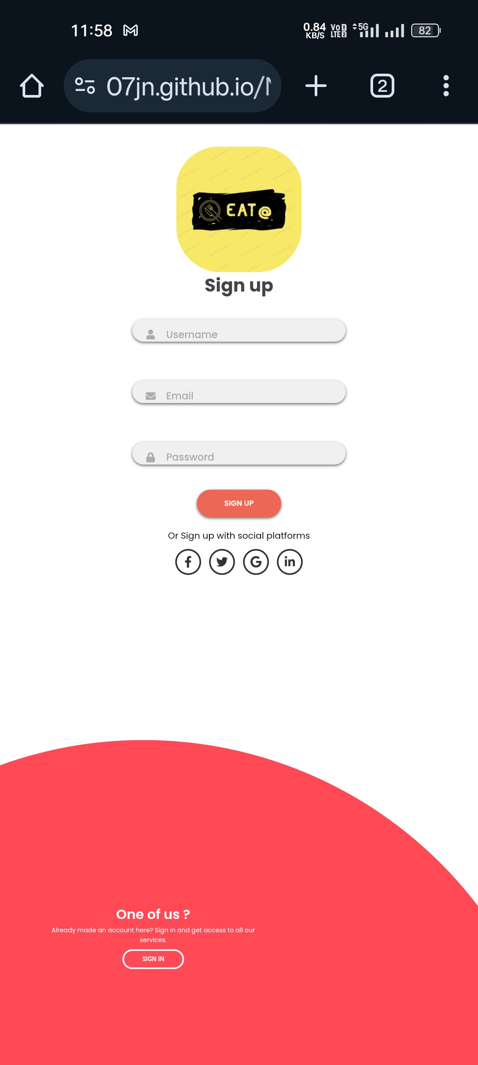
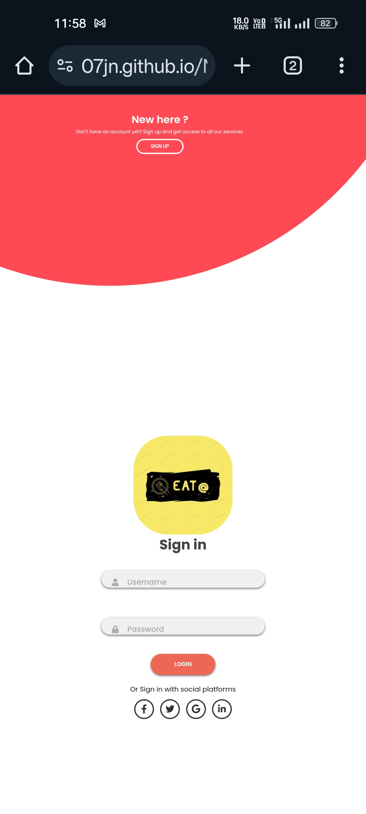
Screenshots:

Slide 8
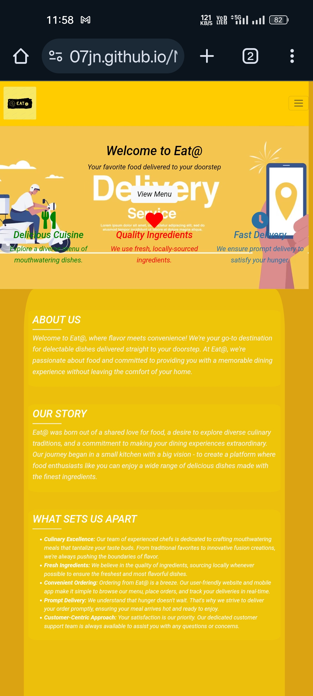
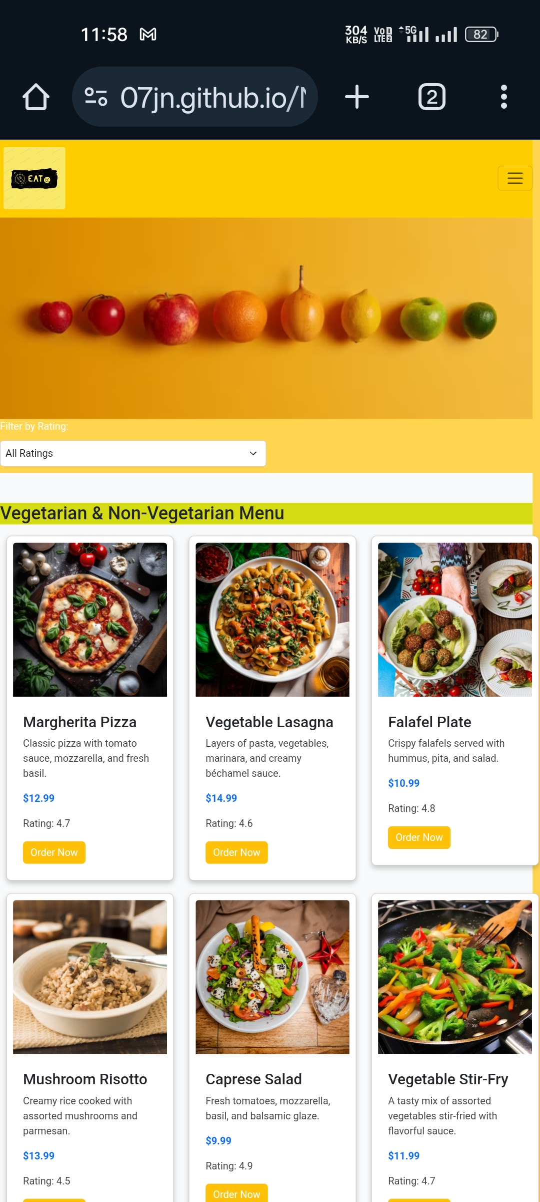

Slide 9
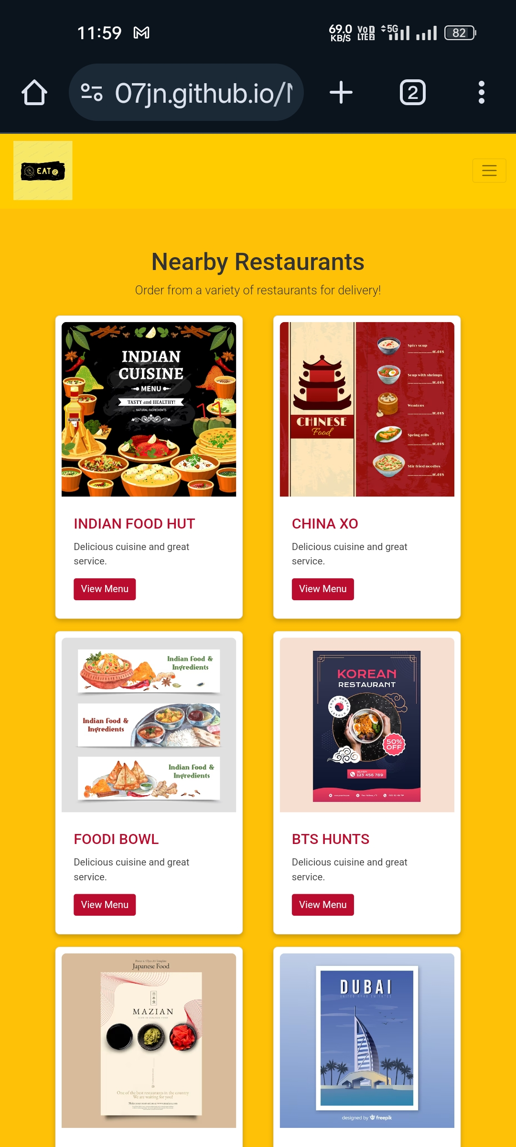
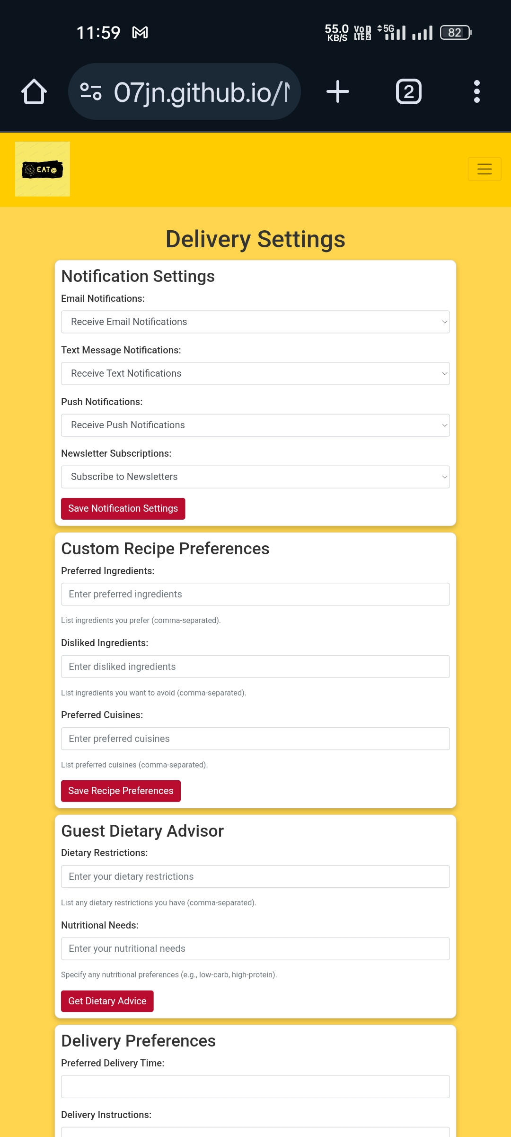

Slide 10
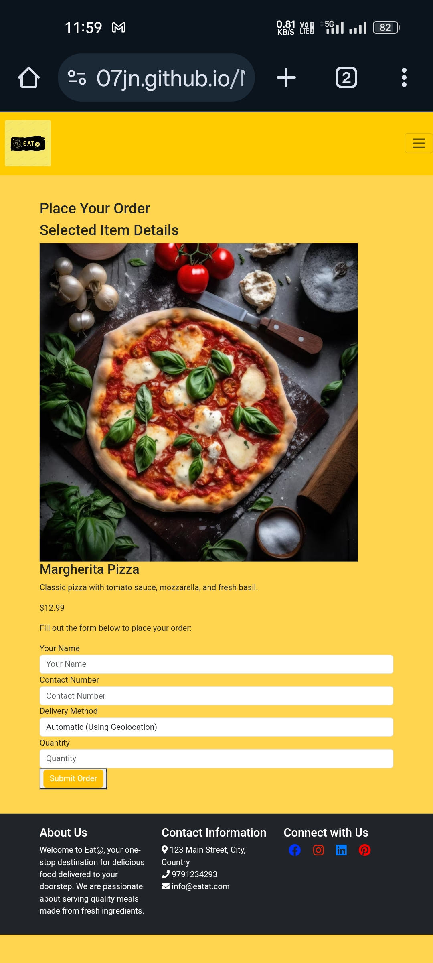
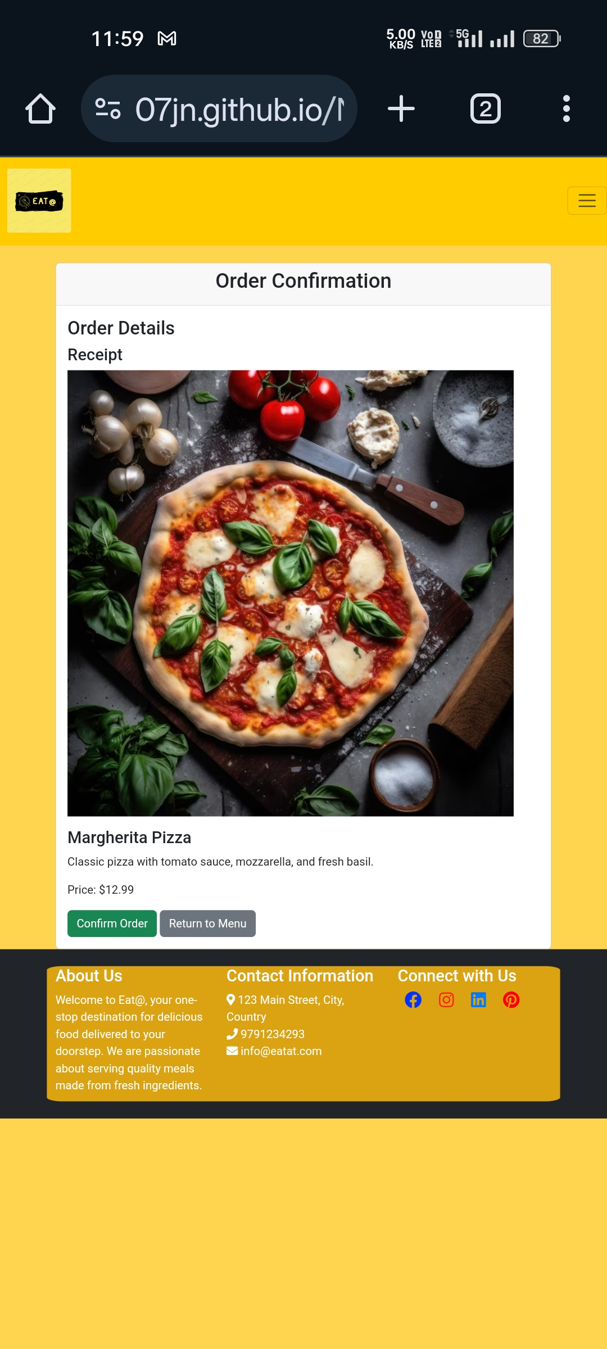

Slide 11
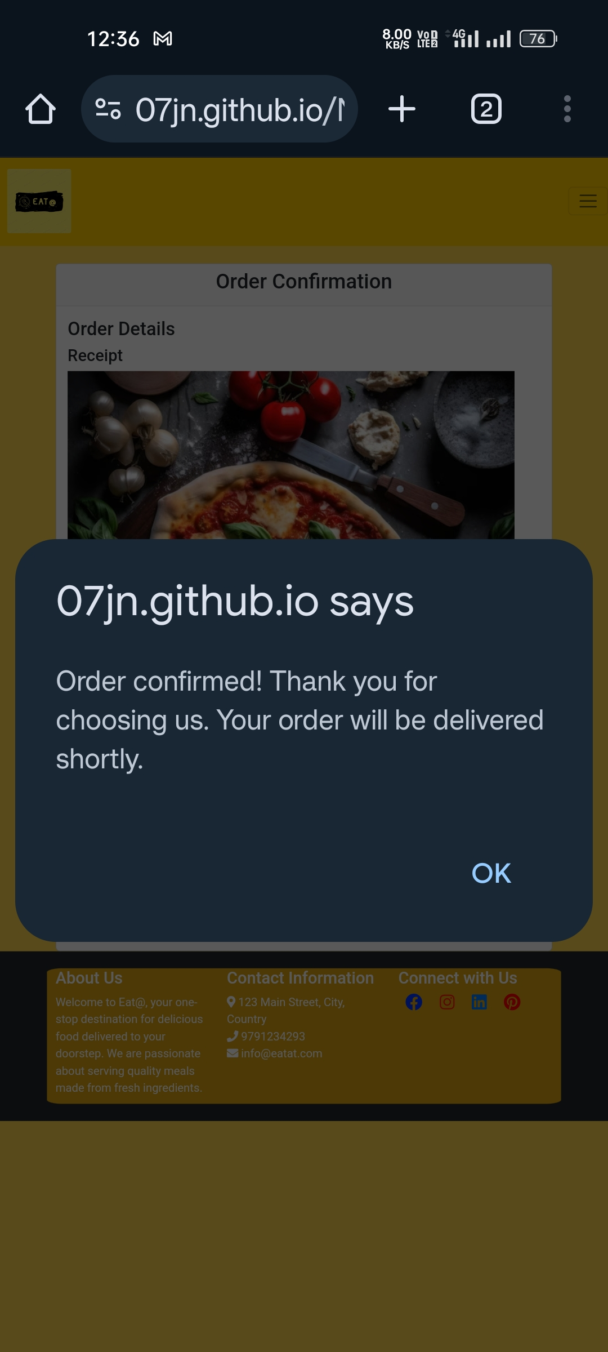

Slide 12
Submission Github
https://github.com/07JN
https://github.com/lankeesh007
https://github.com/Asura1706
https://github.com/hariiiiiiii

Slide 13


